Slide 1

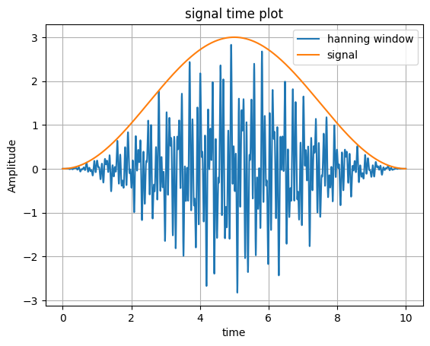
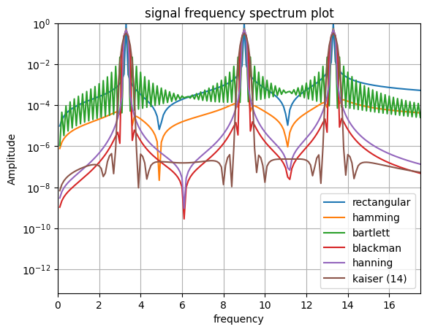
Windowing
Jack Henry jbh48 Cian Phillips cp792 Lab Group 54

Slide 2
What and why?
A method to analyze signals accurately
In order to put in place the correct improvements
Eg mass dampers have to be tuned to the correct frequency
Windowing can be used for any arbitrary signal
We will look at a specific signal made up of the 3 modes of vibration for the building model we used

Slide 3
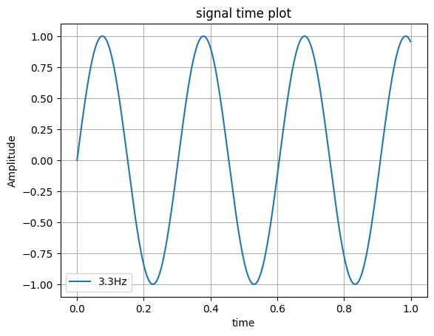
Signal
Mode 1:
3.3Hz

Slide 4
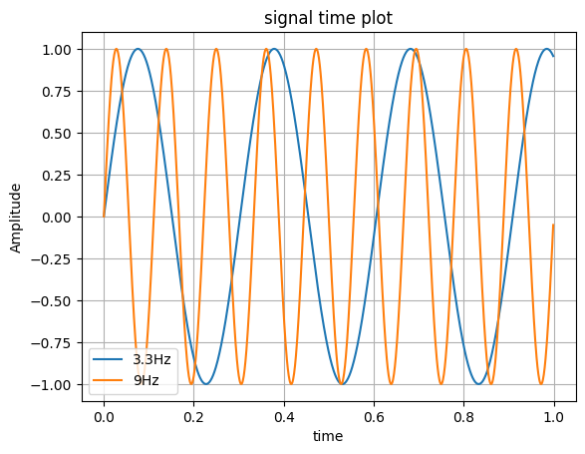
Signal
Mode 2:
9Hz

Slide 5
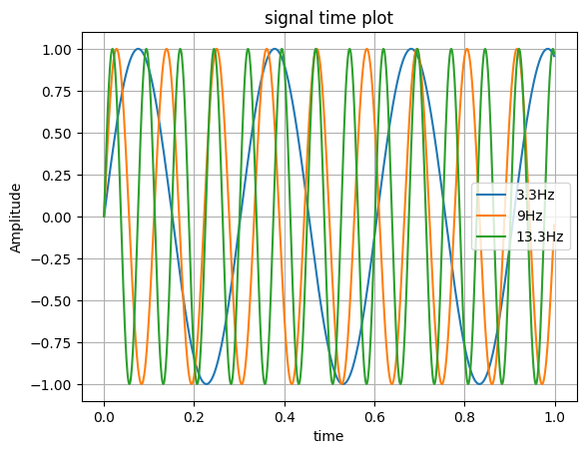
Signal
Mode 3:
13.3Hz

Slide 6
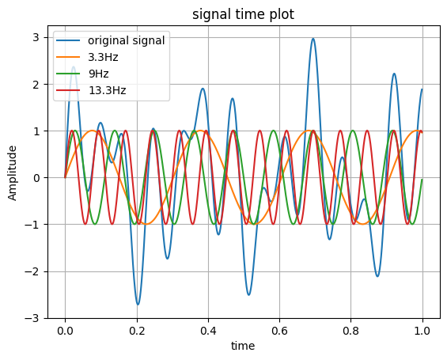
Signal
Superposition

Slide 7
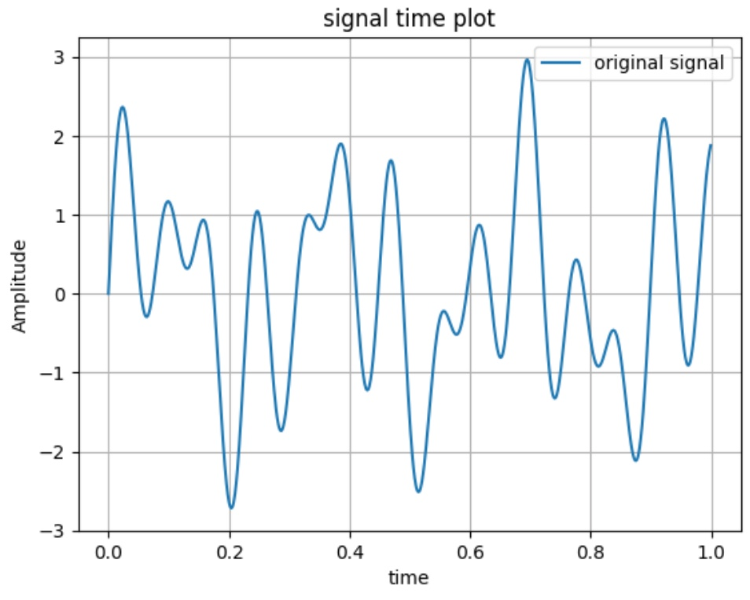
Signal
Signal generated at 1kHz
1 second of a 10 second signal

Slide 8
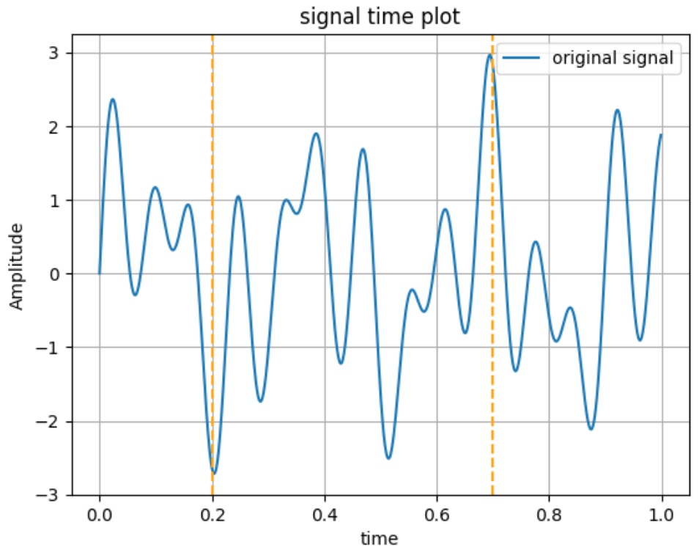
Applying DFT or FFT
Samples measured across a finite period of time
Here is a 0.5s
(or 2% of signal to 7% of signal)

Slide 9
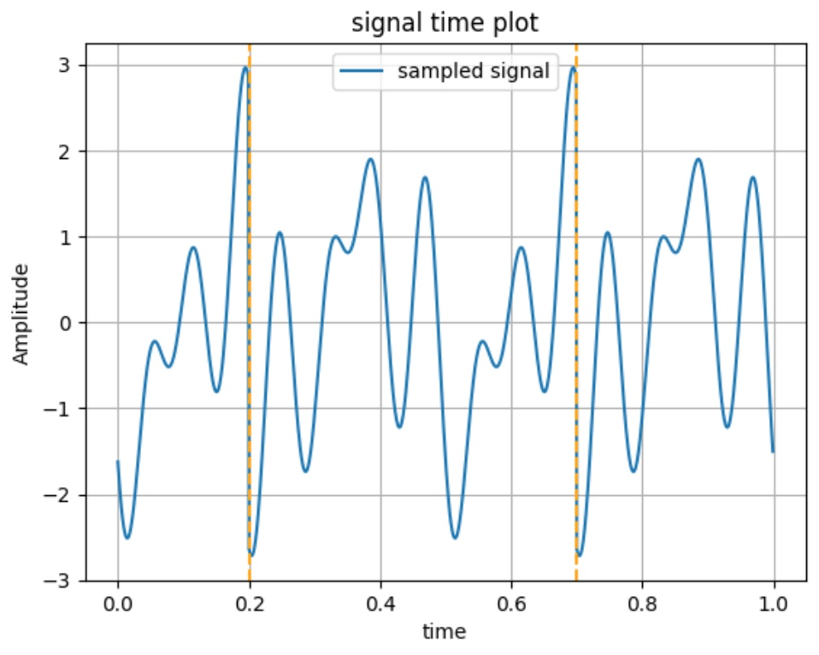
The Problem with DFT
Creates discontinuities that are treated as part of the original signal in the DFT
This (along with sampling accuracy) causes Spectral Leakage

Slide 10
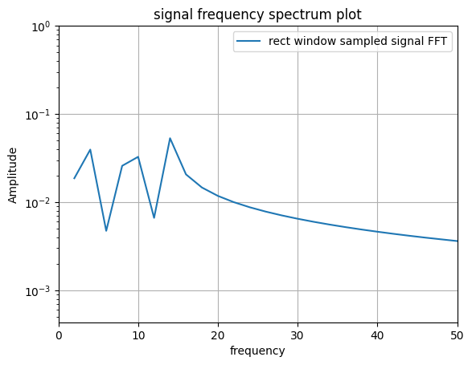
Sampled signal FFT: (10s rectangular window)
Should be getting 3 impulses
Effectively a rectangular window over 0.5s, hence spectral leakage
(Code also limiting resolution)

Slide 11
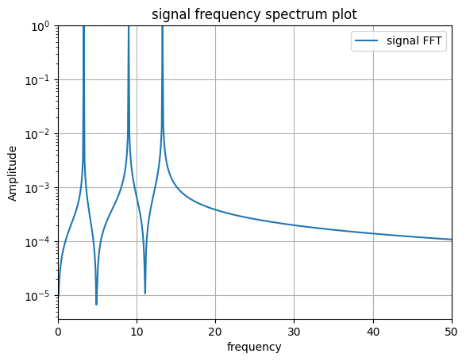
Increasing time period
Increased to maximum of 10s
Effectively a rectangular window over 10s

Slide 12
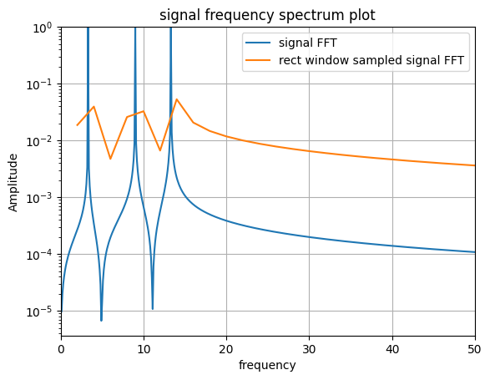
Increasing time period
Increased to maximum of 10s
Effectively a rectangular window over 10s

Slide 13
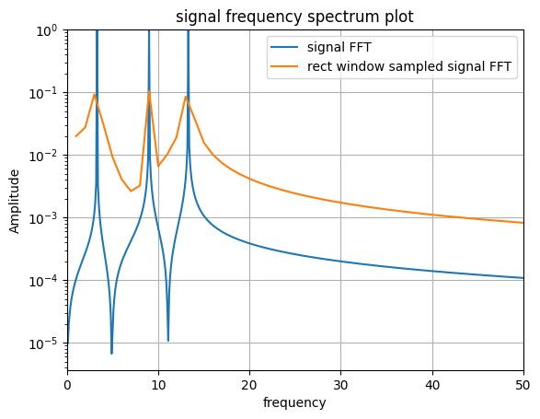
Increasing time period
Increased to maximum of 10s
Effectively a rectangular window over 10s

Slide 14
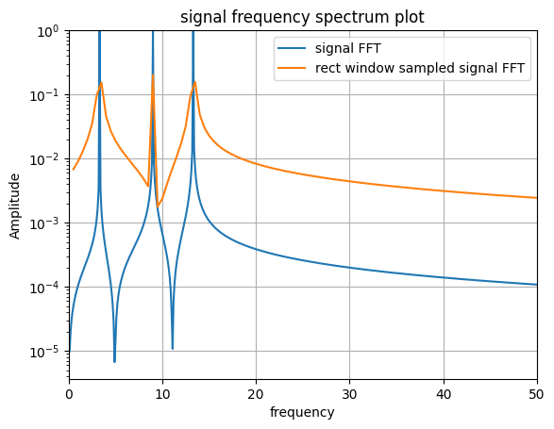
Increasing time period
Increased to maximum of 10s
Effectively a rectangular window over 10s

Slide 15
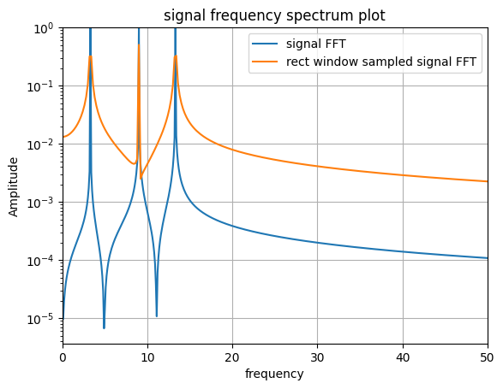
Increasing time period
Increased to maximum of 10s
Effectively a rectangular window over 10s

Slide 16
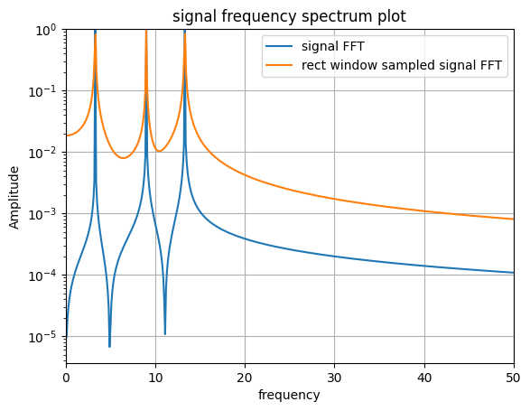
Problems
99% and 100% relative window shown on left
Even with 99% or 100% of signal time lots of spectral leakage
Sensitive to number and placement of discontinuities

Slide 17
Solution: Different Windows
Apply a window that starts and ends at 0 to eliminate discontinuities
(on small time period for clarity)
Notes:
Cian

Slide 18
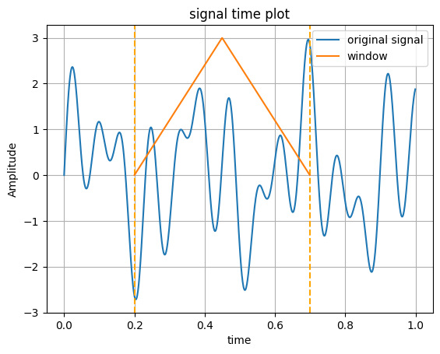
Solution: Different Windows
Apply a window that starts and ends at 0 to eliminate discontinuities

Slide 19
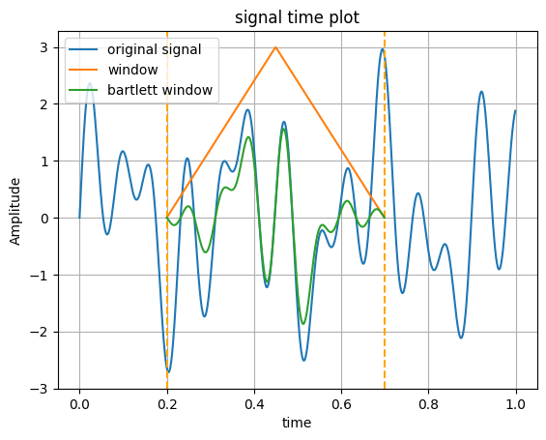
Solution: Different Windows
Apply a window that starts and ends at 0 to eliminate discontinuities

Slide 20
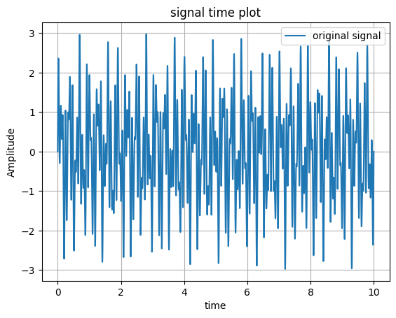
Solution: Different Windows
Across entire 10 seconds:

Slide 21
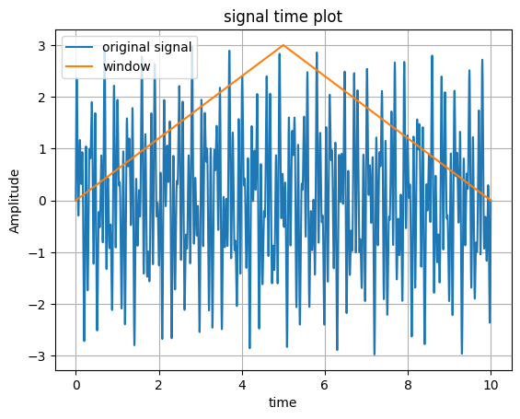
Solution: Different Windows
Across entire 10 seconds:

Slide 22
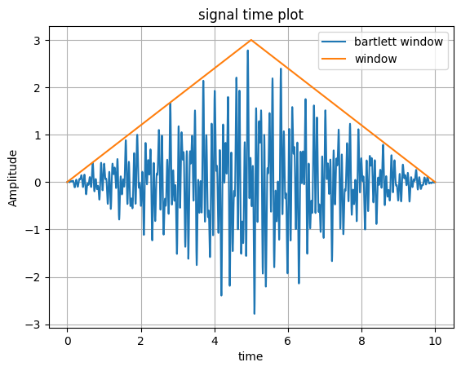
Solution: Different Windows
Across entire 10 seconds:

Slide 23
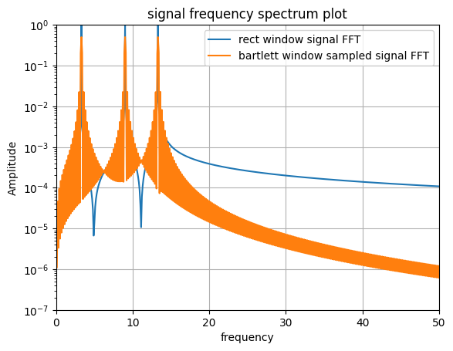
Different Window Spectra
Triangle window spectrum, across entire 10 seconds

Slide 24
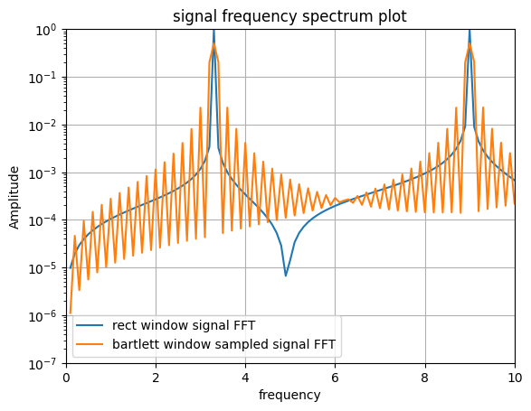
Different Window Spectra
Zoomed in we can see more detail

Slide 25
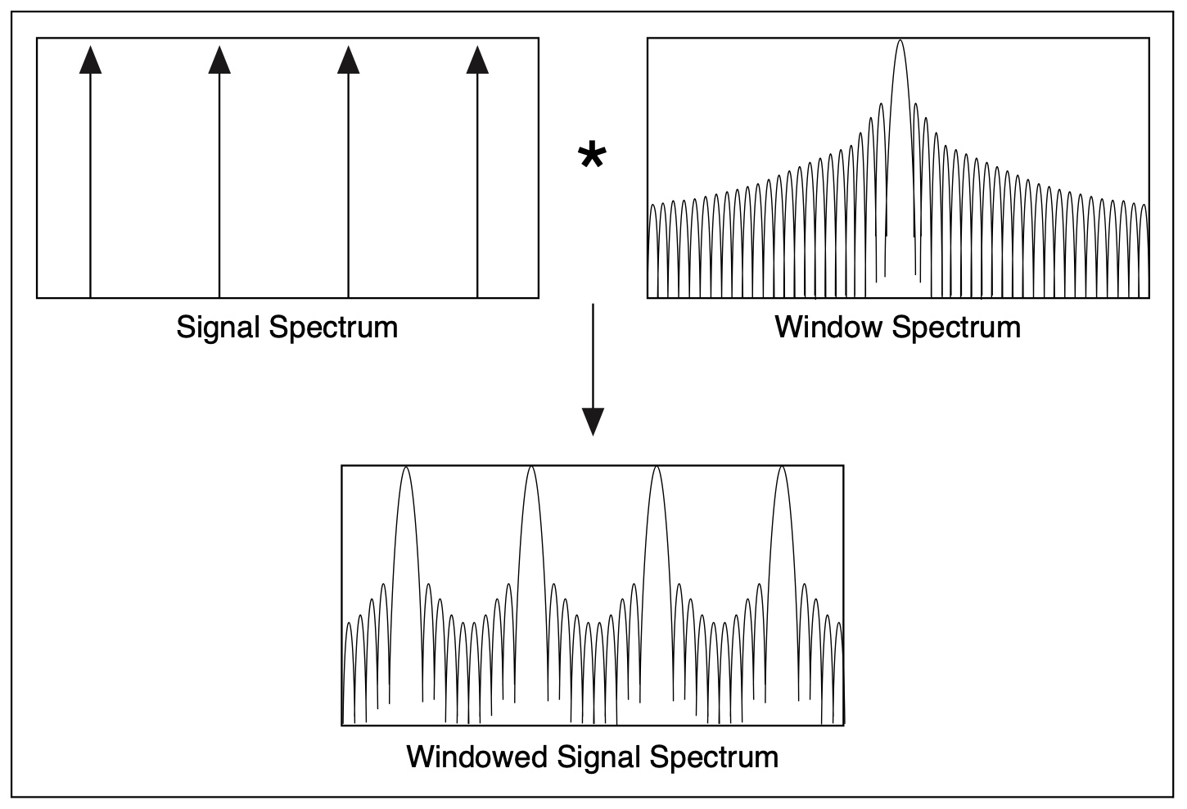
What’s actually going on?

Slide 26
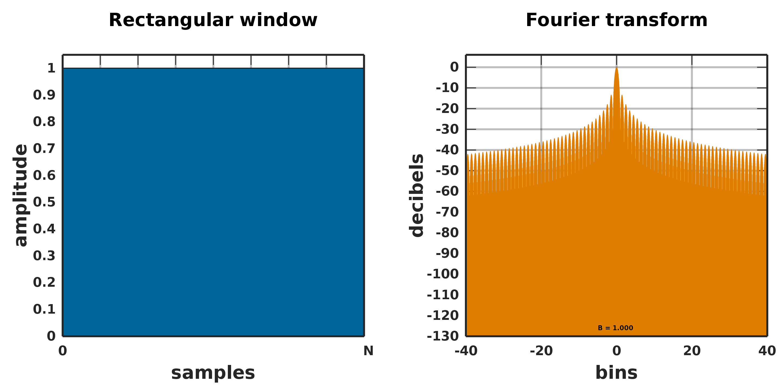
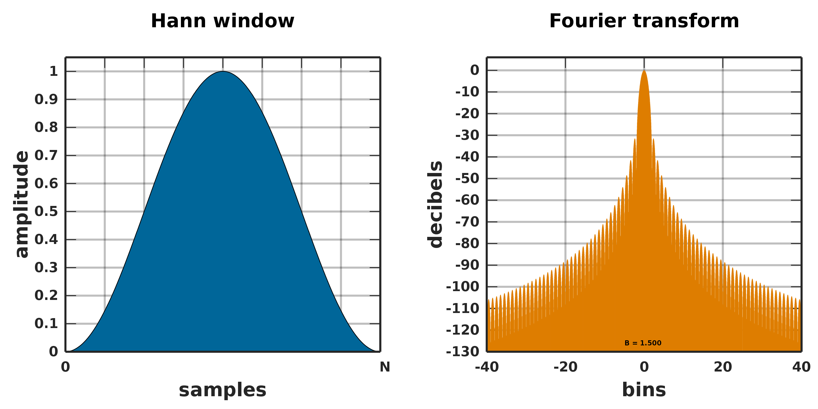
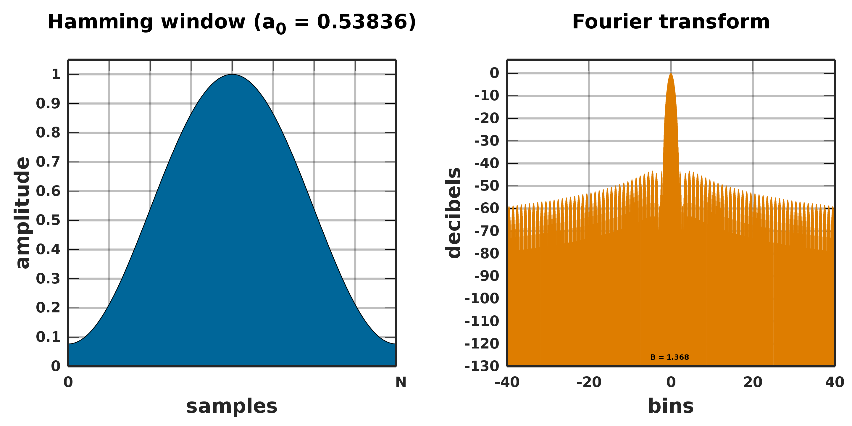
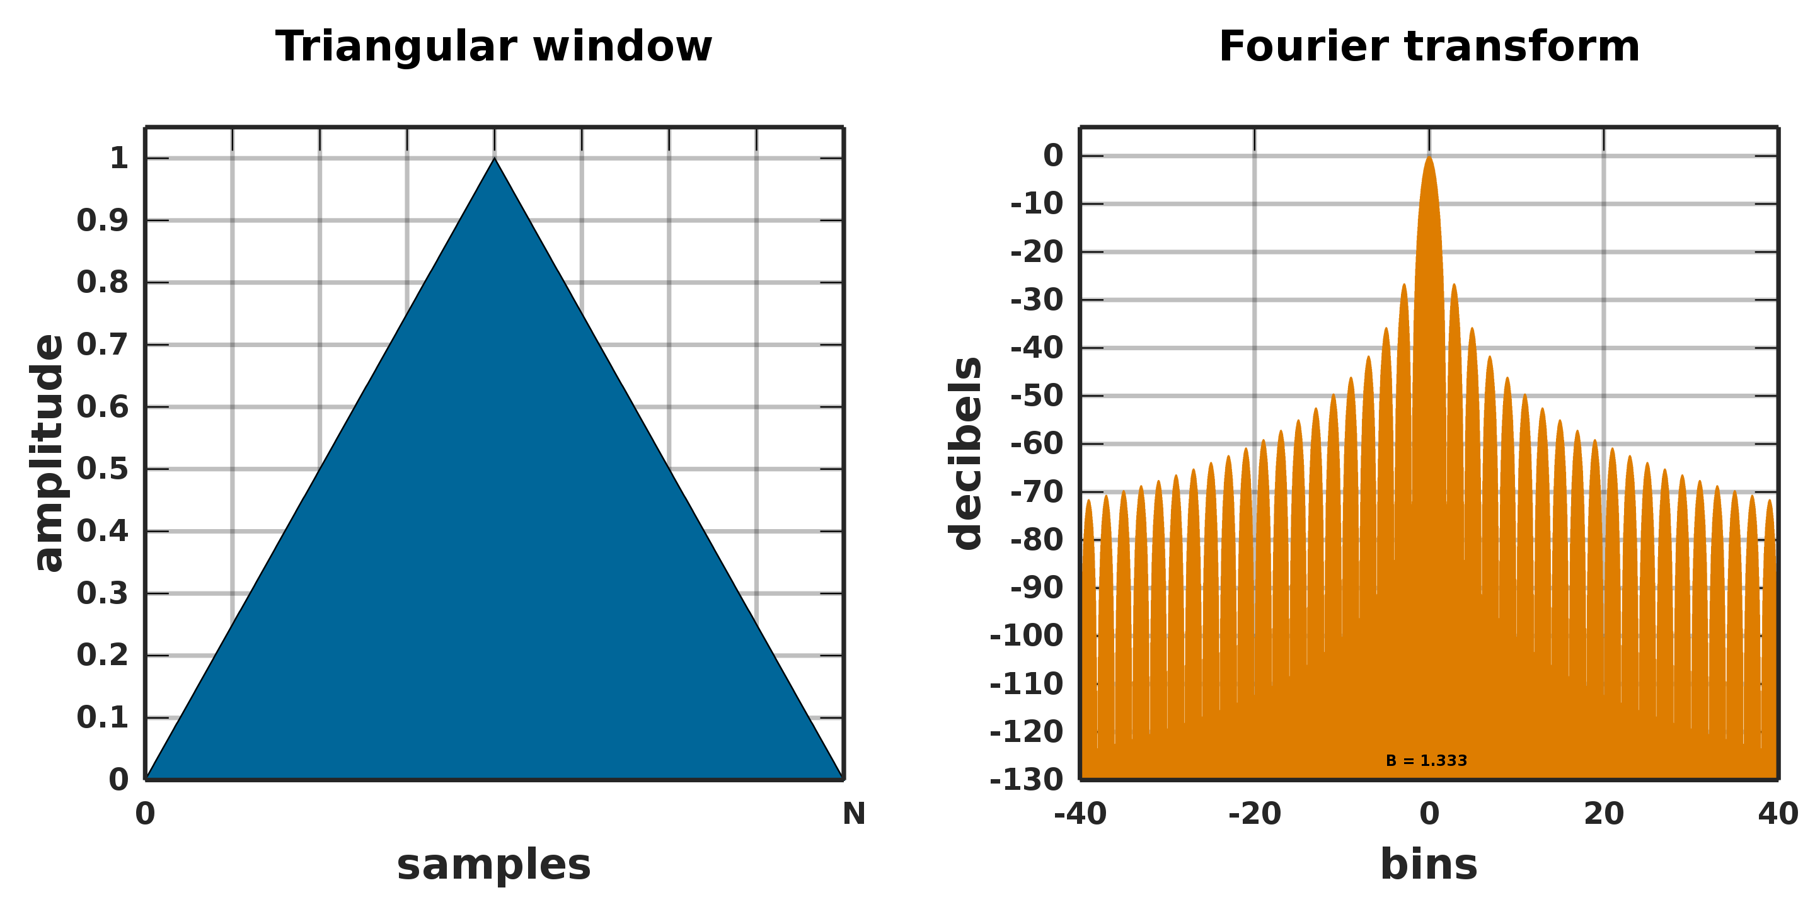
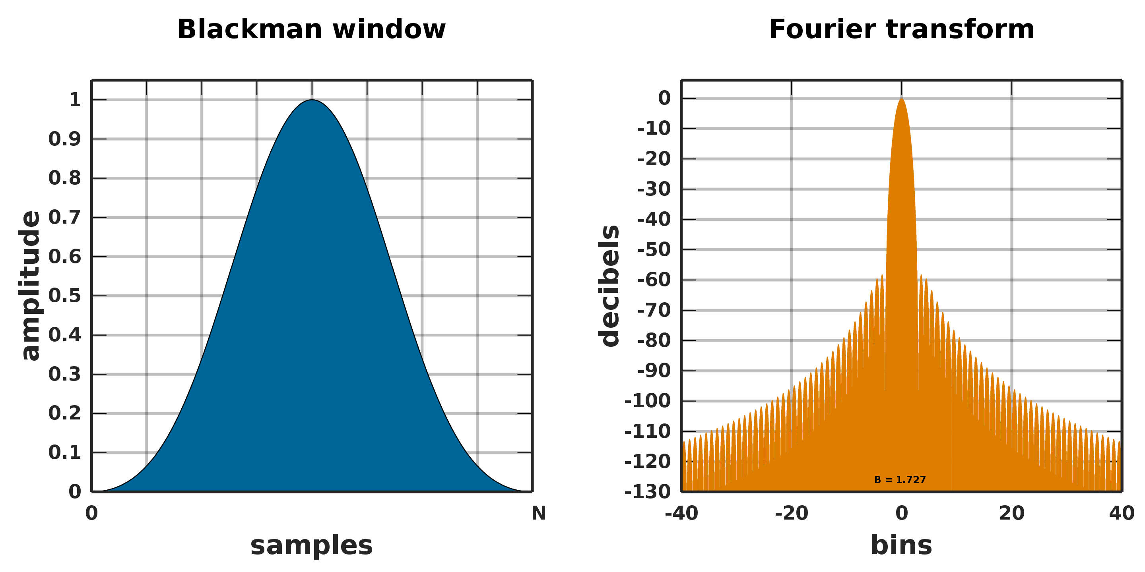
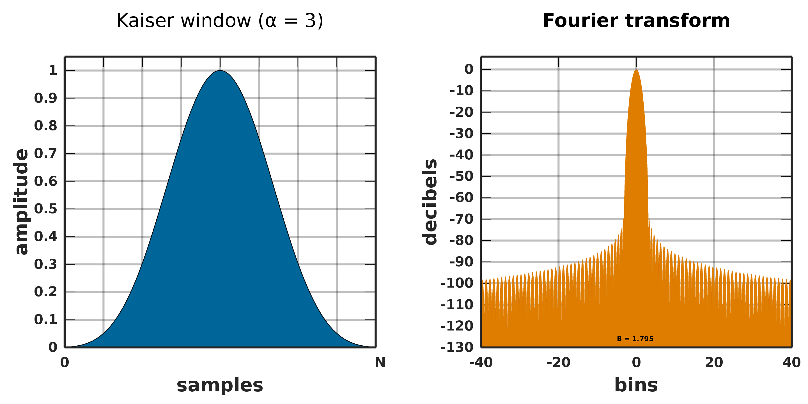
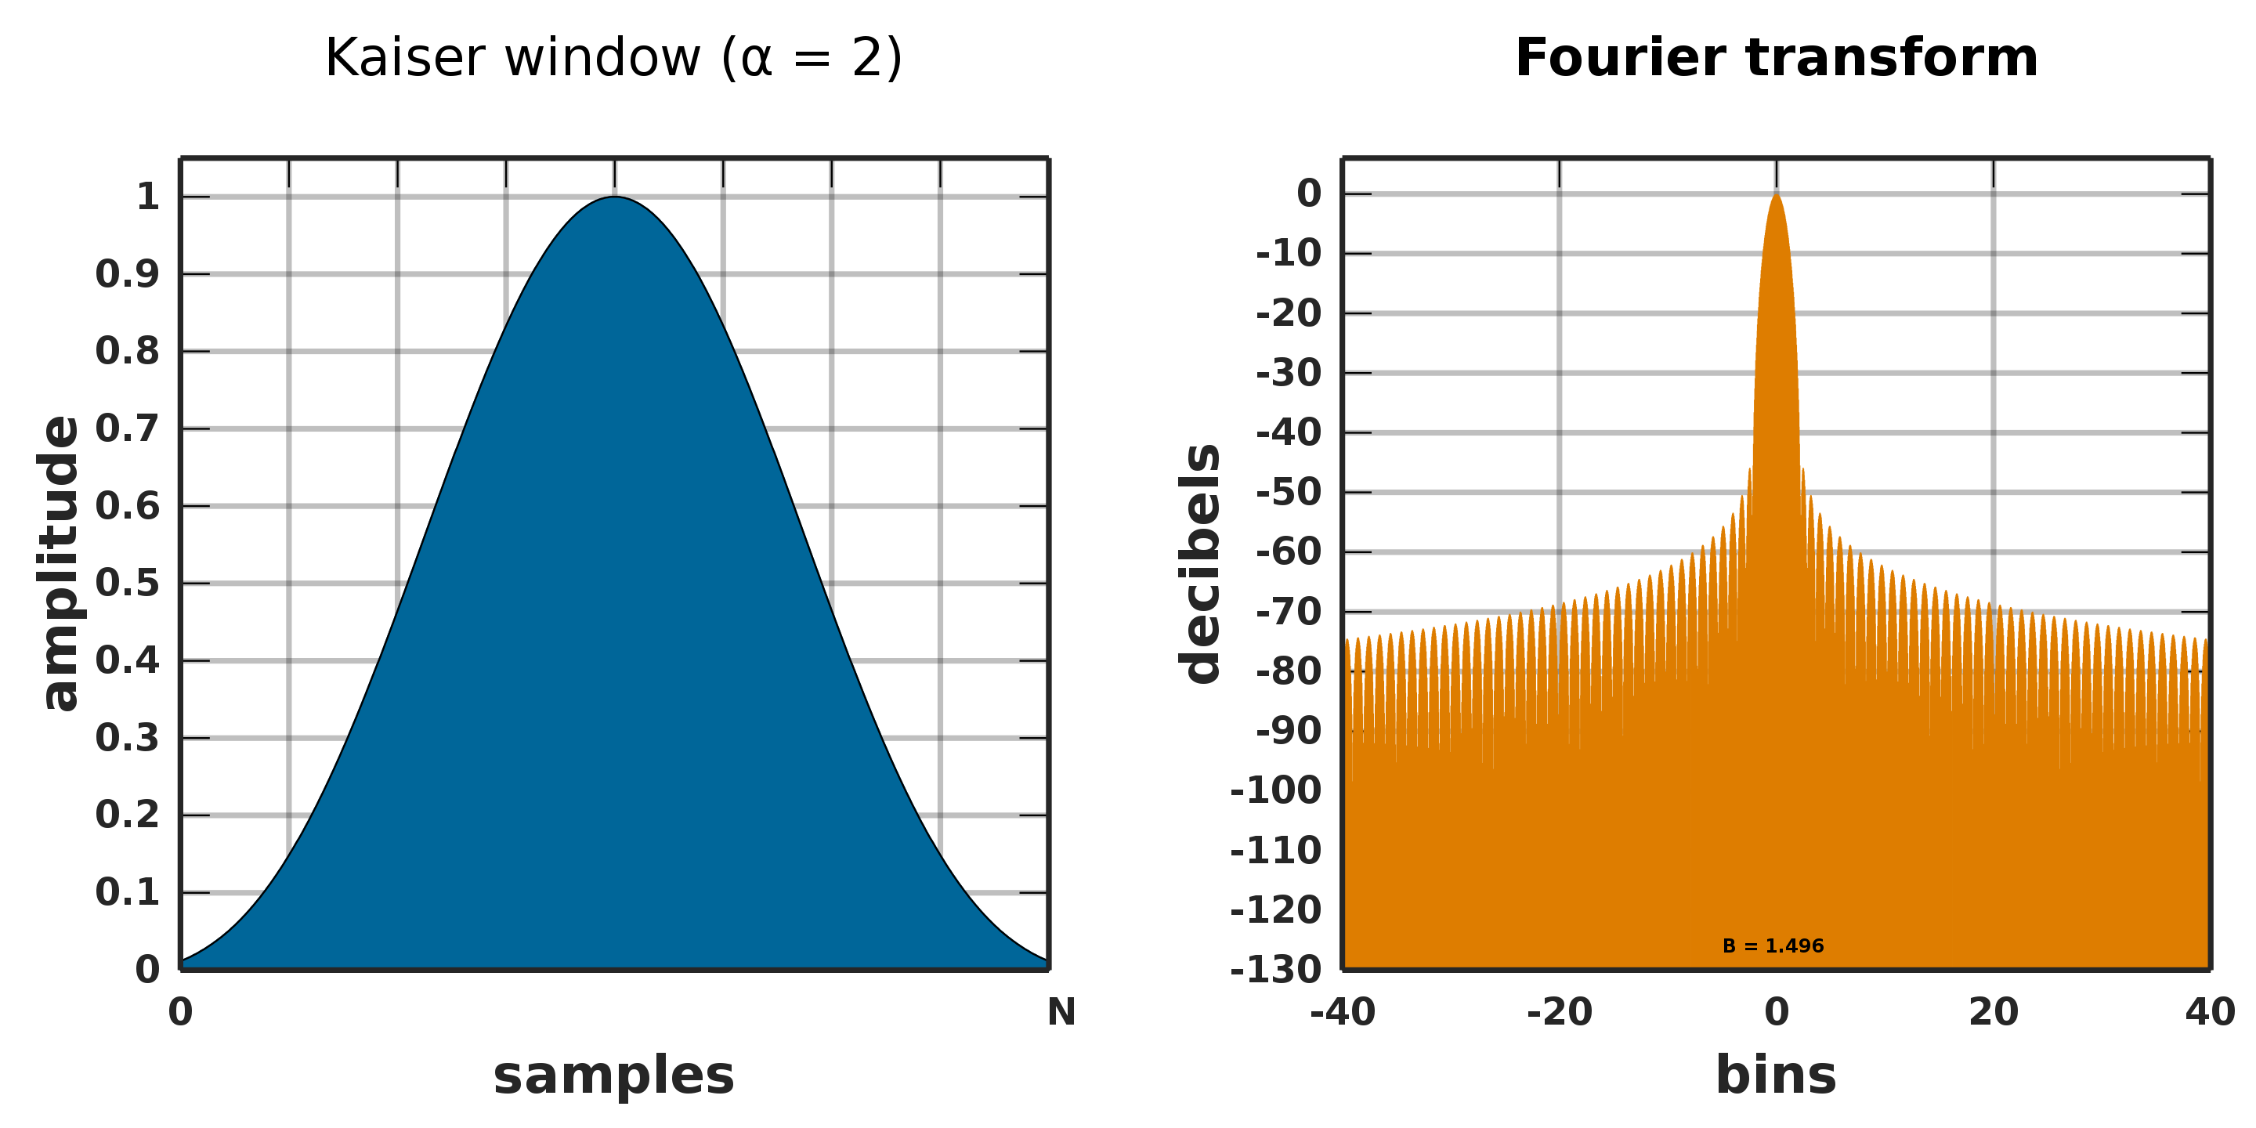
Different windows and their spectra
Hamming doesn’t start and end at 0
(Aka
Bartlett)
Some of many windows
Kaiser has a ‘narrowing’ parameter

Slide 27
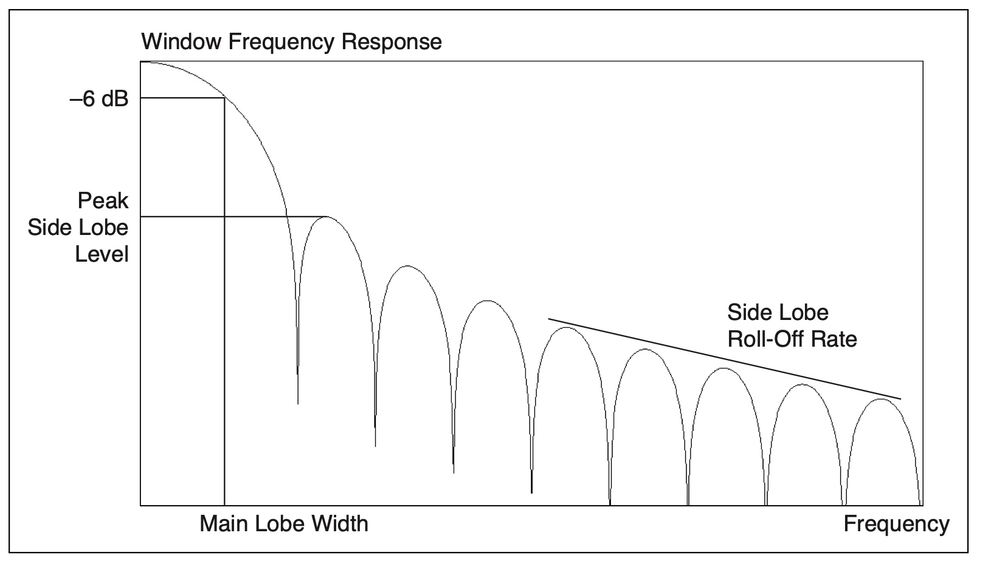
What’s good?
Characteristics:
Main lobe width
Side lobe max
Side lobe roll-off
Two or more signals very near to each other = a very narrow main lobe
Amplitude accuracy of a single frequency component more important than location = wide main lobe
Flat signal spectrum = Uniform/rectangular window (no window)
Hann window is satisfactory in 95% of cases - good frequency resolution and reduced spectral leakage.
Notes:
Jack

Slide 28
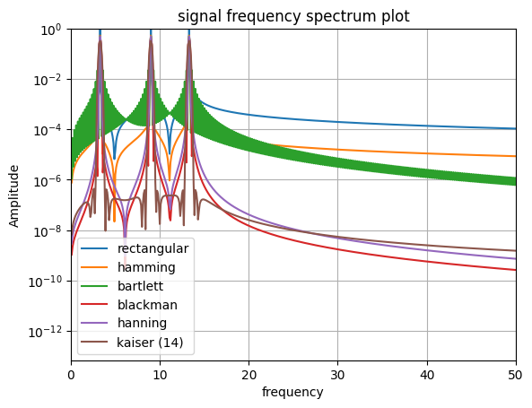
Applied to our signal
Generally, there is a compromise between main lobe width and spectral leakage

Slide 29
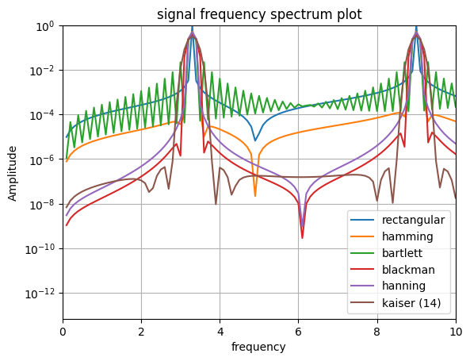
Applied to our signal
Generally, there is a compromise between main lobe width and spectral leakage

Slide 30
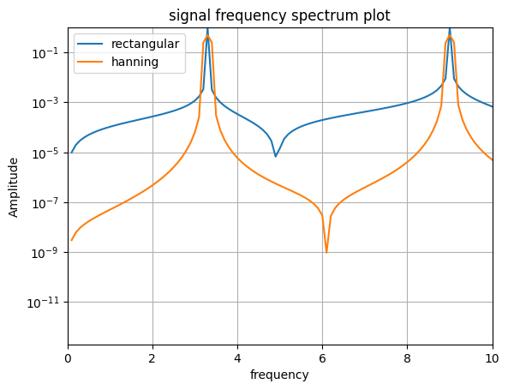
Applied to the building
Hanning best for compromise
Rectangular best for accuracy if need to fine tune mass dampers

Slide 31
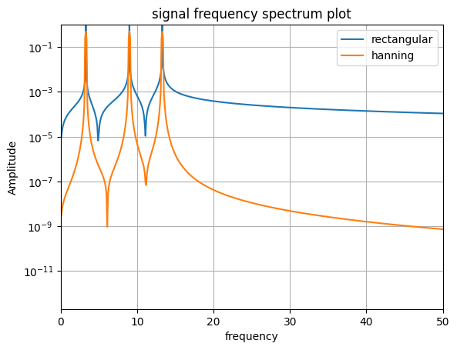
Applied to the building
Hanning best for compromise
Much lower spectral leakage for high frequencies
Changes when noise is introduced….

Slide 32
Thank you Any Questions?
https://en.wikipedia.org/wiki/Window_function
https://www.sjsu.edu/people/burford.furman/docs/me120/FFT_tutorial_NI.pdf

Slide 33
import numpy as np
from numpy.fft import fft, fftfreq
import matplotlib.pyplot as plt
signaltime = 10 # time that signals run for
sr = 1000 # sample rate (per second)
sp = 1/sr # sample interval
sn = signaltime *sr # number of samples
t = np.linspace(0,signaltime, sn) # time array
def signal(f1,f2,f3, noise=False):
signals = ([f1,1],[f2,1], [f3,1]) # signals generated (based on mode frequencies)
sig = np.zeros(len(t)) # 0 array for signals
if noise==False:
for i in signals: # effectively sampling the signals at desired sample rate and superposing over each other
sig += i[1] * np.sin(2 * np.pi * i[0] * t) # + np.random.rand(t.size))
if noise==True:
for i in signals: # with noise
sig += i[1] * np.sin(2 * np.pi * i[0] * t + np.random.rand(t.size))
return sig
f1 = 3.3
f2 = 9
f3 = 13.3
signal = signal(f1,f2,f3, noise=True)
uw = (1/100)*100 #percentage of total time for window
lw = (1/100)*0
windowupper = int(uw*signaltime*sr) # upper window limit (in time)
windowlower = int(lw*signaltime*sr) # lower window limit (in time)
windowwidth = windowupper - windowlower # window width (in time), and also number of samples within window
sampledsignal = signal[windowlower:windowupper] # sampled signal only in windowed time space
wf1 = np.hamming(windowwidth) # creating hamming window function
ws1 = sampledsignal*wf1 # applying hamming window to reduced sampled signal
wf2 = np.bartlett(windowwidth) # creating bartlett window
ws2 = sampledsignal * wf2 # applying bartlett window to reduced sampled signal
wf3 = np.blackman(windowwidth)
ws3 = sampledsignal *wf3 # creating and applying blackman window to reduced sampled signal
wf4 = np.hanning(windowwidth)
ws4 = sampledsignal *wf4
wf5 = np.kaiser(windowwidth,14)
ws5 = sampledsignal *wf5
repeats = -(sn // -windowwidth) +1
repeatedsampledsignal = np.tile(sampledsignal,repeats)[windowwidth-windowlower%windowwidth:(windowwidth-windowlower%windowwidth)+sn]
x = fftfreq(sn, sp)[:sn//2]
y = fft(signal)[:sn//2]
xf = fftfreq(windowwidth, sp)[:windowwidth//2] # frequency array
yf = fft(sampledsignal)[:windowwidth//2] # FFT of sampled signal
yfw1 = fft(ws1)[:windowwidth//2] # FFT of sampled signal with hamming window
yfw2 = fft(ws2)[:windowwidth//2] # FFT of sampled signal with bartlett window
yfw3 = fft(ws3)[:windowwidth//2] # FFT of sampled signal with blackman window
yfw4 = fft(ws4)[:windowwidth//2] # FFT of sampled signal with hanning window
yfw5 = fft(ws5)[:windowwidth//2] # FFT of sampled signal with kaiser window
yw1 = fft(wf1)[:windowwidth//2] # FFTs of purely the window
yw2 = fft(wf2)[:windowwidth//2]
yw3 = fft(wf3)[:windowwidth//2]
yw4 = fft(wf4)[:windowwidth//2]
yw5 = fft(wf5)[:windowwidth//2]

Slide 34
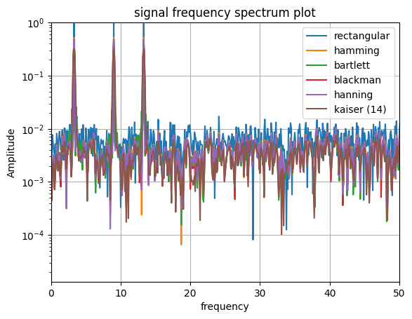
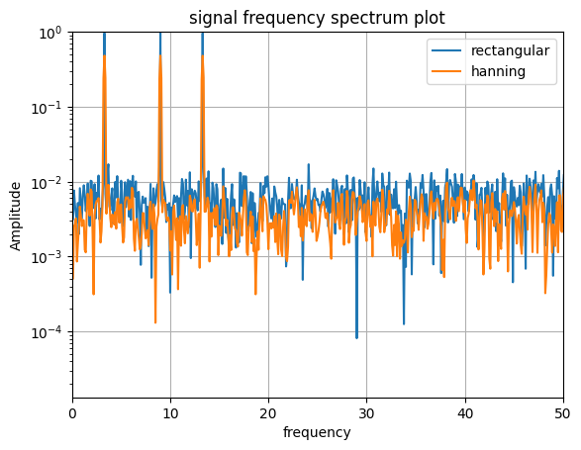
Noise

Slide 35
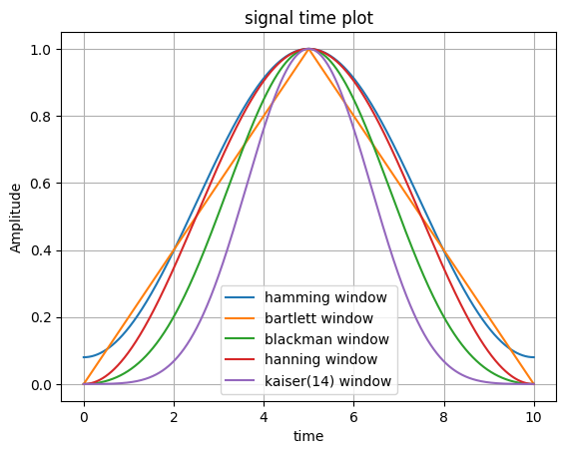
Windows (python)

